Slide 1
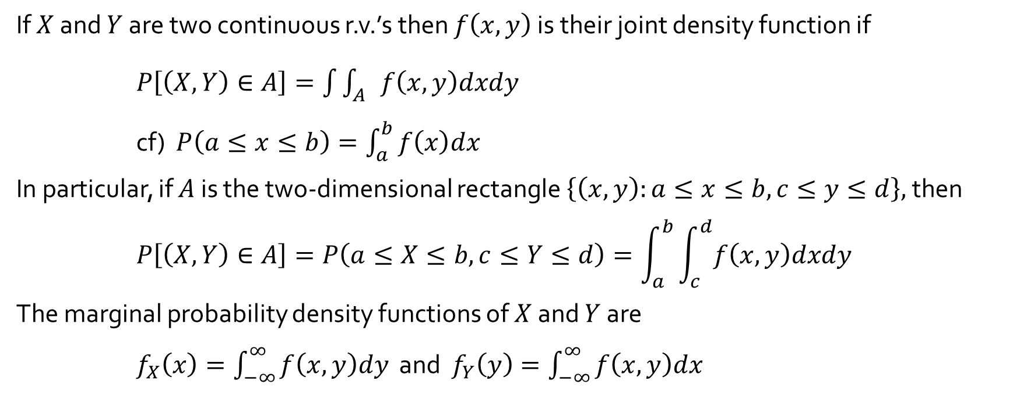
Joint Probability Density Function
If $X$ and $Y$ are two continuous r.v.’s then $f\left(x, y\right)$ is their joint density function if
$P\left[\left(X, Y\right)∈A\right]=\int{\int_{A}{f\left(x, y\right)dxdy}}$
cf) $P\left(a≤x≤b\right)=\int_{a}^{b}{f\left(x\right)dx}$
In particular, if $A$ is the two-dimensional rectangle $\left\{\left(x, y\right):a≤x≤b, c≤y≤d\right\},$then
$$P\left[\left(X, Y\right)∈A\right]=P\left(a≤X≤b, c≤Y≤d\right)=\int_{a}^{b}{\int_{c}^{d}{f\left(x, y\right)dxdy}}$$
The marginal probability density functions of $X$ and $Y$ are
$f_{X}\left(x\right)=\int_{−∞}^{∞}{f\left(x, y\right)dy}$ and $f_{Y}\left(y\right)=\int_{−∞}^{∞}{f\left(x, y\right)dx}$

Slide 2
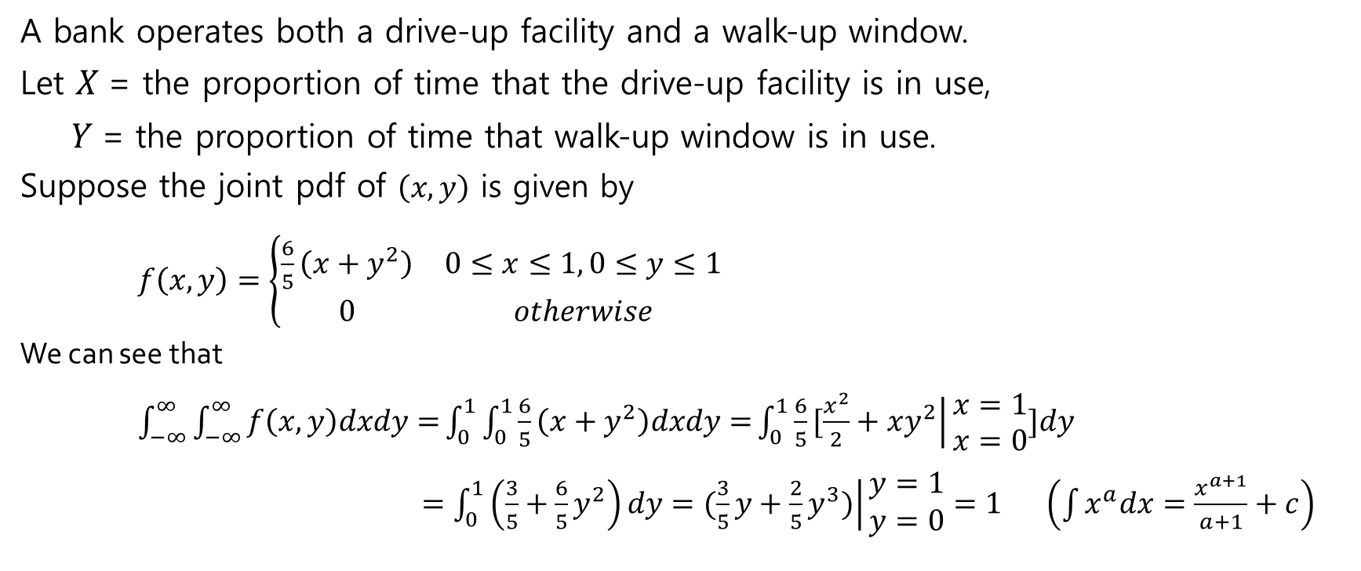
Example of Joint Probability Density : Example 5.3
A bank operates both a drive-up facility and a walk-up window.
Let $X$= the proportion of time that the drive-up facility is in use,
$Y$= the proportion of time that walk-up window is in use.
Suppose the joint pdf of $\left(x, y\right)$ is given by
$f\left(x, y\right)=\left\{\begin{matrix}\frac{6}{5}\left(x+y^{2}\right) & 0≤x≤1, 0≤y≤1 \\ 0 & otherwise\end{matrix}\right.$
We can see that
$\int_{−∞}^{∞}{\int_{−∞}^{∞}{f\left(x, y\right)dxdy=}}\int_{0}^{1}{\int_{0}^{1}{\frac{6}{5}\left(x+y^{2}\right)dxdy=}}\int_{0}^{1}{\frac{6}{5}[\left.\frac{x^{2}}{2}+xy^{2}\right|}\begin{matrix}x=1 \\ x=0\end{matrix}]dy$
$=\int_{0}^{1}{\left(\frac{3}{5}+\frac{6}{5}y^{2}\right)dy}=\left.(\frac{3}{5}y+\frac{2}{5}y^{3})\right|\begin{matrix}y=1 \\ y=0\end{matrix}=1$ $\left(\int{x^{a}dx=\frac{x^{a+1}}{a+1}+c}\right)$

Slide 3
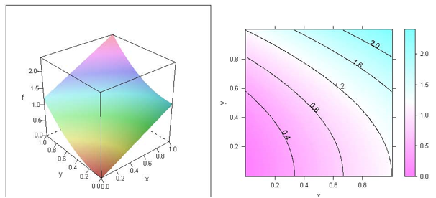
Contour line : shows the same height

Slide 4

Example of Joint Probability Density : Example 5.3
$P\left(0≤X≤\frac{1}{4},0≤Y≤\frac{1}{4}\right)=\int_{0}^{1/4}{\int_{0}^{1/4}{\frac{6}{5}\left(x+y^{2}\right)dxdy}}$
$=\int_{0}^{1/4}{\frac{6}{5}[\left.\frac{x^{2}}{2}+xy^{2}\right|}\begin{matrix}x=1/4 \\ x=0 \end{matrix}]dy$
$=\int_{0}^{1/4}{\frac{6}{5}\left(\frac{1}{32}+\frac{1}{4}y^{2}\right)dy}=\frac{6}{5}\left.(\frac{1}{32}y+\frac{1}{12}y^{3})\right|\begin{matrix}y=1/4 \\ y=0 \end{matrix}$
$=\frac{6}{5}\left(\frac{1}{32}×\frac{1}{4}+\frac{1}{12}×\frac{1}{64}\right)=\frac{7}{640}=0.0109$

Slide 5
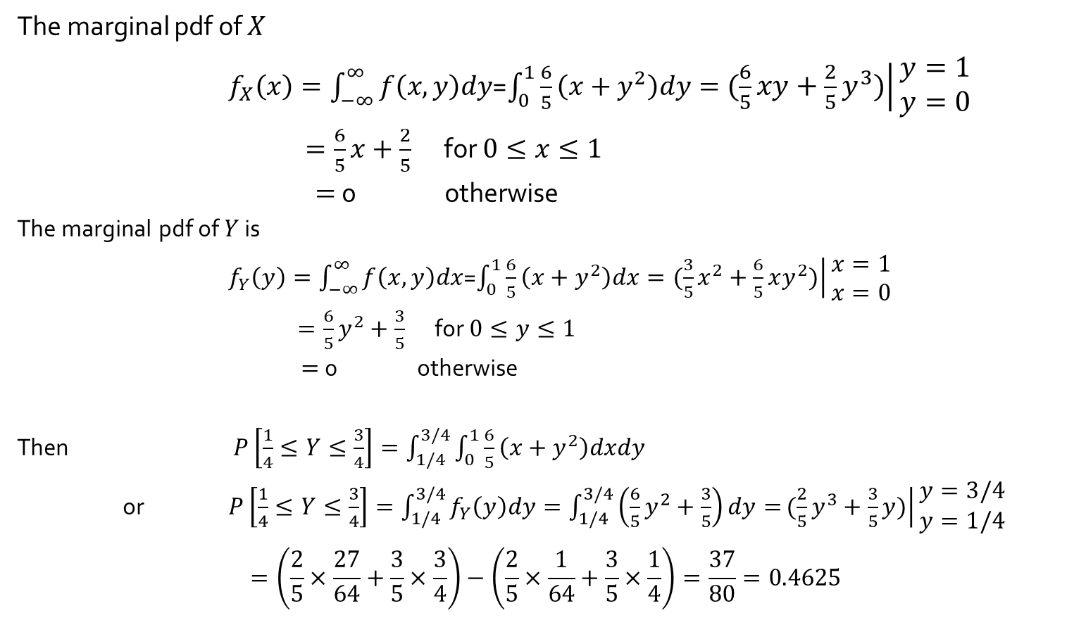
The marginal pdf of $X$
$f_{X}\left(x\right)=\int_{−∞}^{∞}{f\left(x, y\right)dy}$=$\int_{0}^{1}{\frac{6}{5}\left(x+y^{2}\right)dy}=\left.(\frac{6}{5}xy+\frac{2}{5}y^{3})\right|\begin{matrix}y=1 \\ y=0\end{matrix}$
$=\frac{6}{5}x+\frac{2}{5}$ for $0≤x≤1$
$=$ 0 otherwise
The marginal pdf of $Y$ is
$f_{Y}\left(y\right)=\int_{−∞}^{∞}{f\left(x, y\right)dx}$=$\int_{0}^{1}{\frac{6}{5}\left(x+y^{2}\right)dx}=\left.(\frac{3}{5}x^{2}+\frac{6}{5}xy^{2})\right|\begin{matrix}x=1 \\ x=0\end{matrix}$
$=\frac{6}{5}y^{2}+\frac{3}{5}$ for $0≤y≤1$
$=$ 0 otherwise
Then $P\left[\frac{1}{4}≤Y≤\frac{3}{4}\right]=\int_{1/4}^{3/4}{\int_{0}^{1}{\frac{6}{5}\left(x+y^{2}\right)dxdy}}$
or $P\left[\frac{1}{4}≤Y≤\frac{3}{4}\right]=\int_{1/4}^{3/4}{f_{Y}\left(y\right)dy}=\int_{1/4}^{3/4}{\left(\frac{6}{5}y^{2}+\frac{3}{5}\right)dy=}\left.(\frac{2}{5}y^{3}+\frac{3}{5}y)\right|\begin{matrix}y=3/4 \\ y=1/4\end{matrix}$
$$=\left(\frac{2}{5}×\frac{27}{64}+\frac{3}{5}×\frac{3}{4}\right)−\left(\frac{2}{5}×\frac{1}{64}+\frac{3}{5}×\frac{1}{4}\right)=\frac{37}{80}=0.4625$$

Slide 6
